Slide 1
INTRODUCTION TO MEDICAL ETHICS

Slide 2
CONCEPTS
ETHICS
MORALS
DEONTOLOGY
BIOETHICS
BIOMEDICAL ETHİCS
ACTION
VIRTUE

Slide 3
ETHICS
In Greek “Ethos”
Good, well, temperament, character
The code of ethics are defined by the reactions of the society
It has no legal obligation
It depends on the time and place
A systematic thinking on morals
The theory of the action

Slide 4
MORALS
Arabic “Halak”, creation, temperament
The practice of the action
The rules that regulate the relationship between the other beings according to certain values
Signification and value depend on relationship between human beings
Intention, action and result must be good
Preferring the better one instead of wicked one

Slide 5
DEONTOLOGY
Science of duty
Medical deontology contains responsibilities to
“yourself”
“your colleagues”
“the society”

Slide 6
BIOETHICS/BIOMEDICAL ETHİCS
It deals with the moral values problems of medicine, health-care services and biologic sciences
Subheadings of bioethics
“Clinical Ethics” on supplying health-care services
“Research Ethics” protects the research participants
“Work Ethics” on duties and responsibilities
“Public Policy and Governmental Ethics ” prepare the ground for the law

Slide 7
ACTION
It is the object of the ethics
Action consists of
“evaluation”
“related life”
“execution”
Ethics deal with the intention, form, aim and result of the action

Slide 8
VIRTUE
Honesty, justice, respect, love, trust
Wisdom, continence, courage
Moral perfection
It is the basis of the ethical behaviors

Slide 9
Medicine and the Ethics
Medicine is both an art and a science
The art of medicine is the practice of medical sciences and technologies on people, families and societies, which are very different from each other
Differences between individuals, families and societies are recognized and considered together

Slide 10
Purpose of the Ethics Classes
To decide the best behavior
To know what to do in hard situations
The code of ethics and regulations

Slide 11
Purpose of the Ethics Classes
Health workers should be exhibit to appropriate ethical values of the identity besides medical knowledge and skills
In the problems of society to follow, to analyze and the scientific perspective to create your own opinion

Slide 12
Ethical Issues
Informed Consent
Patient Rights
Privacy Rights and Medical Privacy
Ethical Issues on Telling the Truth

Slide 13
Ethical Issues
Ethical Issues Related to the Beginning of Life (pregnancy, abortion, assisted reproductive technologies, cloning, genetic and embryo research)
Ethical Issues Related to End of Life (euthanasia, CPR, DNR, refusal of treatment, futility and discontinuation of treatment)
Ethical Issues Related to Organ and Tissue Transplantation
Clinical Research and Ethics of Science

Slide 14
Regulation of Patient Rights’
The right to live in physical, emotional, and social well-being
Everyone's right to life, preserve and develop tangible and intangible assets
Differences in race, language, religion or creed, sex, political opinion, philosophical belief, and economic and social situations can not be considered
Except in cases of medical necessity and the written law, the person's body and other personal rights are inviolable integrity. These can’t be changed without the consent of patient
Person shan’t be subjected to medical research without the consent and permission of the Ministry
Privacy of person and his/her family is inviolable

Slide 15
WMA (World Medical Association)
Declaration of Lisbon on the Rights of the Patient (1981)
The patient has the right
to choose freely and change his/her physician
to refuse/accept the recommended treatment
to privacy
to die with dignity
to receive or to decline spiritual and moral comfort including the help of a minister of his/her chosen religion

Slide 16
WHO (World Health Organization)
The Amsterdam Declaration (1994)
Observance of human rights and values ​​in health care
Care/treatment right
Being informed/consent
Privacy

Slide 17
Ethical Principles
Autonomy
Beneficience
Nonmaleficence
Justice

Slide 18
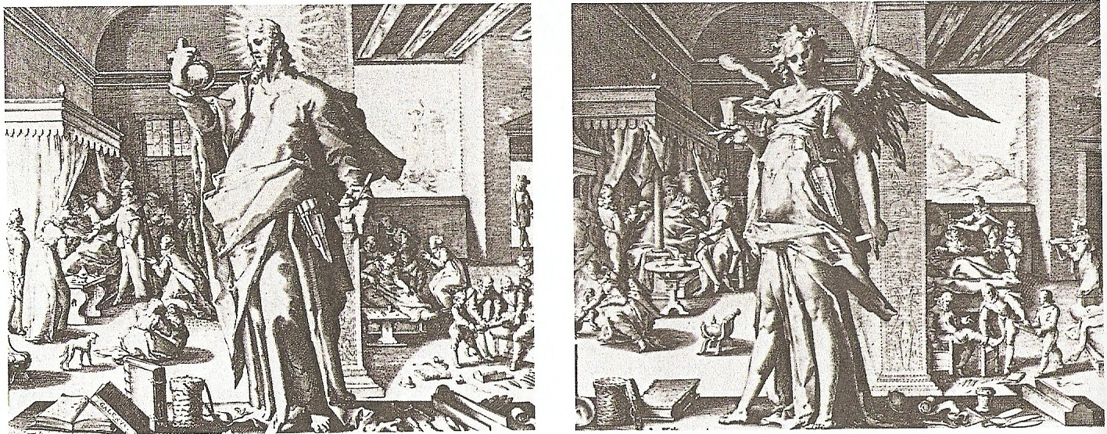
“The allegory of the Medical Profession” (1587) Engravings of Hendrik Goltzius

Slide 19
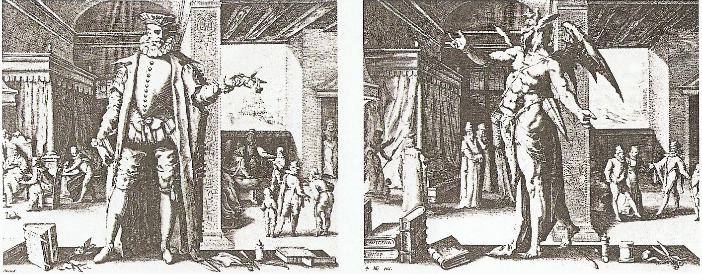
“The allegory of the Medical Profession” (1587) Engravings of Hendrik Goltzius

Slide 20
References
A. Selim ATAY, İnönü Üniversitesi Tıp Fakültesi, translation
Tolga GÜVEN, Marmara Üniversitesi Tıp Tarihi ve Etik AD ders notları
Gürkan SERT, Hasta Hakları
Robert M VEATCH, Medical Ethics
Emine ATABEK, Mebrure DEĞER, Tıbbi Deontoloji Konuları
Hasta Hakları Yönetmeliği, 1998
Klinik Araştırmalar Hakkında Yönetmelik, 2011
Çağlar Boyu Tıp, Roche Yayınları
http://en.wikipedia.org/wiki/Main_Page

